Slide 1
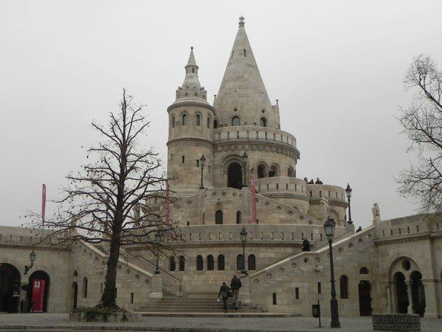
Budapest public meeting
20 October 2016
AICA
&
EUCIP (Core, ITAF) Certifications
Pierfranco Ravotto
AICA

Slide 2

About AICA
Founded in 1961 AICA is the Italian Computer Society, a no-profit association.
Member of IFIP, International Federation of Informatics Professionals.
Member of CEPIS, Council of European Professionals Informatics Societies, a federation of 37 associations from 33 European countries.
Member of ECDL Foundation.
Member of CEN IT Skills Workshop.
Partner in many European projects (at the moment: Elvete, Appskil, OpenQAsS, MASTIS; with IT Study: SME 2.0, IT-Shape, Itaca, OpenQAsS).

Slide 3

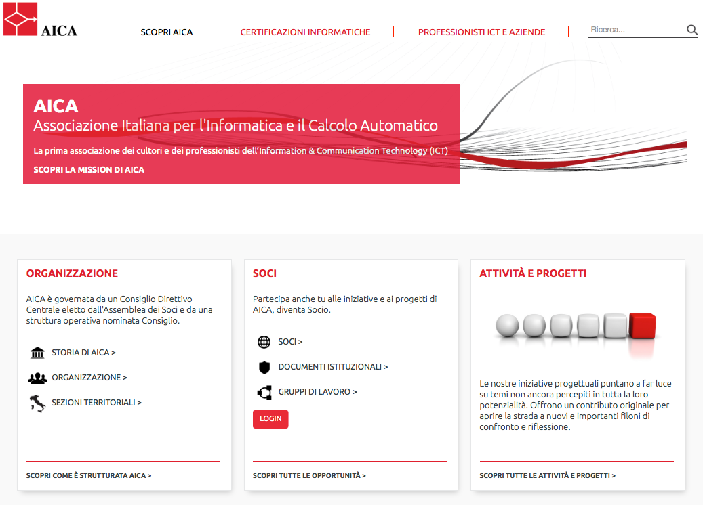
About AICA
www.aicanet.it

Slide 4
About AICA
Promotion of ICT culture
Collaboration with schools &universities
IT certifications (eCitizens, ECDL, EUCIP/e-CFplus)
Services for companies & ICT professionals

Slide 5
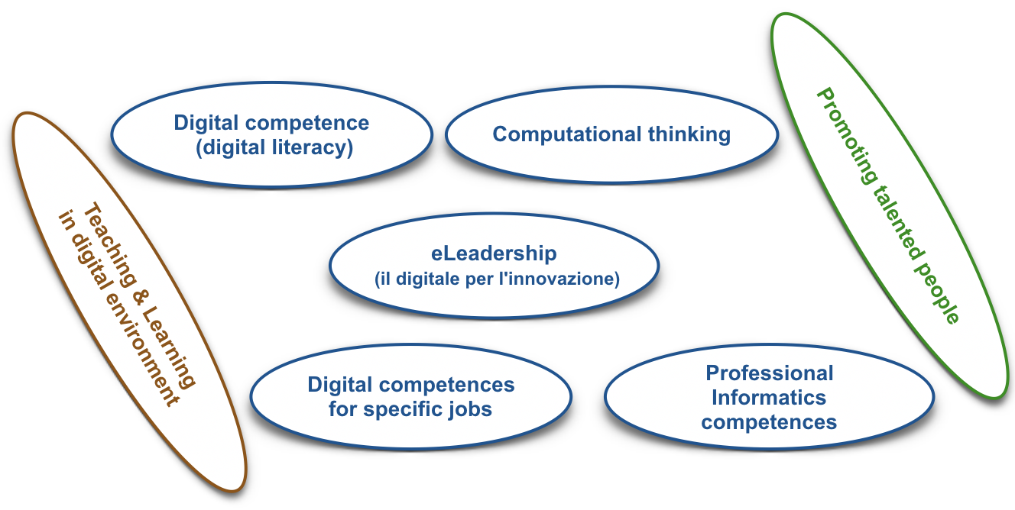
Schools & universities

Slide 6
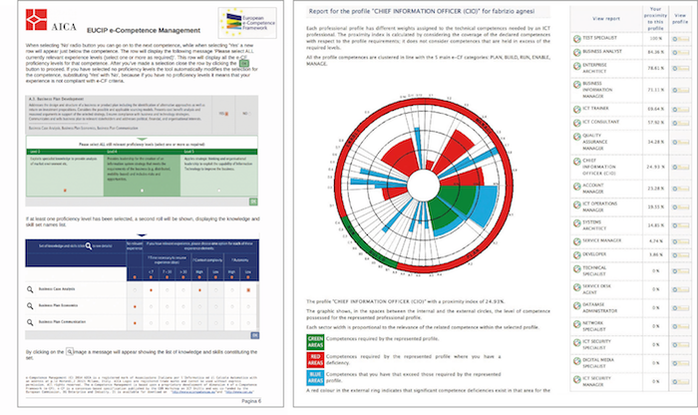
Professionals & Companies
Users’ certifications

Slide 7



About CEPIS
CEPIS is the Council of European Professionals Informatics Societies.
It’s a federation of 37 associations from 33 European countries.
It has promoted:

Slide 8
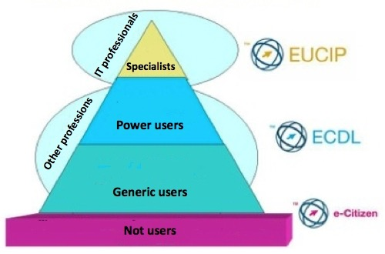
About ECDL Foundation
It manages

Slide 9
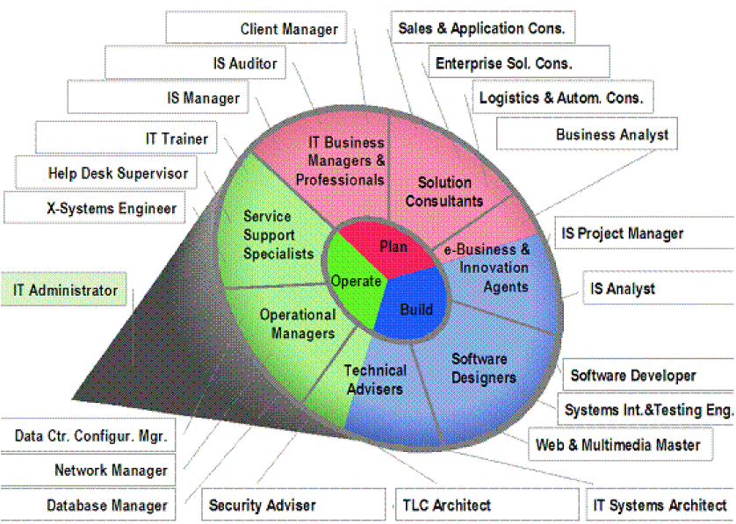
What is EUCIP
A competence framework
& a job profiles system
18 areas of competences
156 competences
3.000 knowledge and skills items

Slide 10
What is EUCIP
A competence framework &
a job profiles system
Professional (21 profiles)
A certification system
Core (Plan, Build, Operate)
IT Administrator

Slide 11
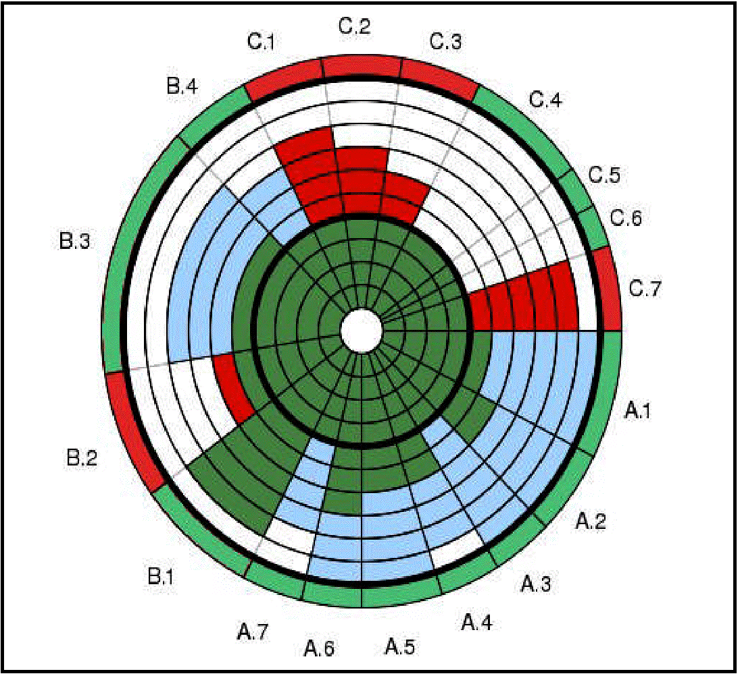
What is EUCIP
A competence framework &
a job profiles system
A certification system
Services offered to companies and professionals

Slide 12


From EUCIP to e-CFplus

Slide 13
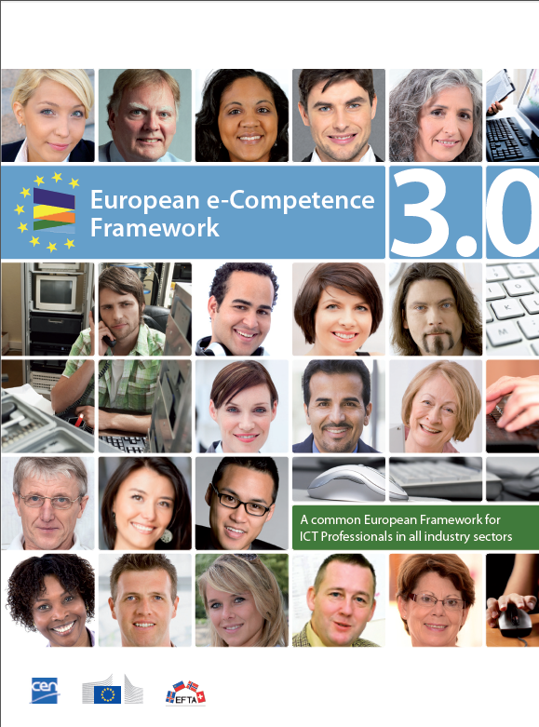



e-Competence Framework
A European wide reference framework of information and communication technologies (ICT) competences that can be used and understood by ICT professionals and human resources managers from ICT user and supply companies, small and medium sized enterprises, the public sector, as well as educational and social partners across the European Union.
A common language
An official standard

Slide 14
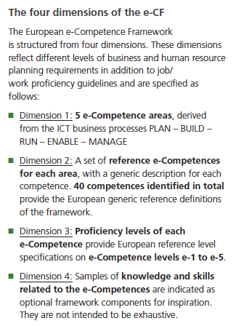
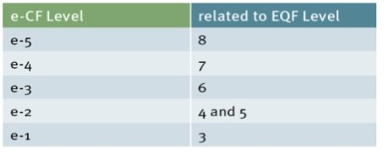
e-CF 4 dimensions
5 areas:
PLAN, BUILD, RUN,
ENABLE and MANAGE
40 e-Competence
Attribution of the 40
e-Competences at one of
5 levels corresponding to
EQF levels from 3 to 8
Samples of Knowledge and Skills
for each e-Competence

Slide 15
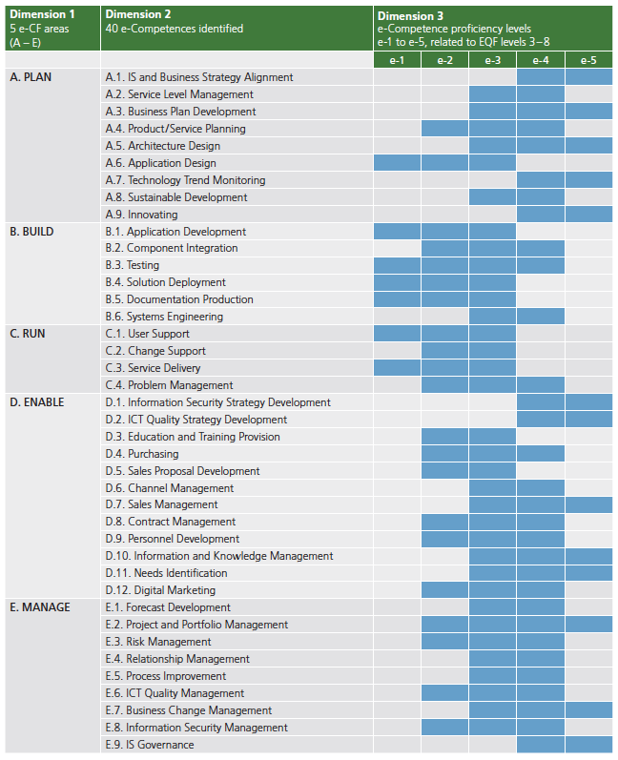
e-CF 40 competences

Slide 16
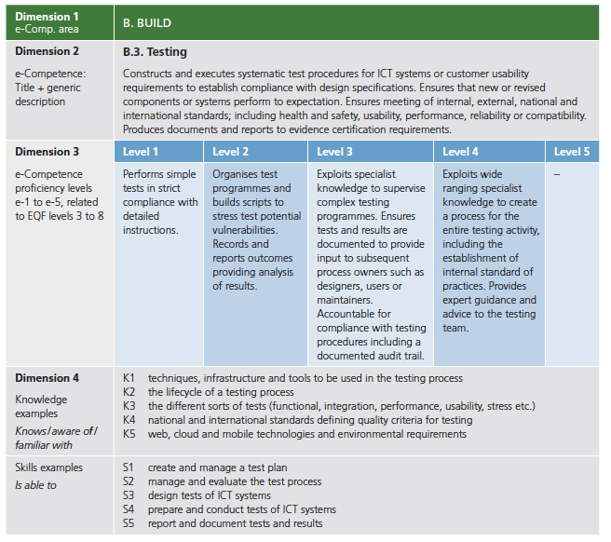
e-CF: an example

Slide 17
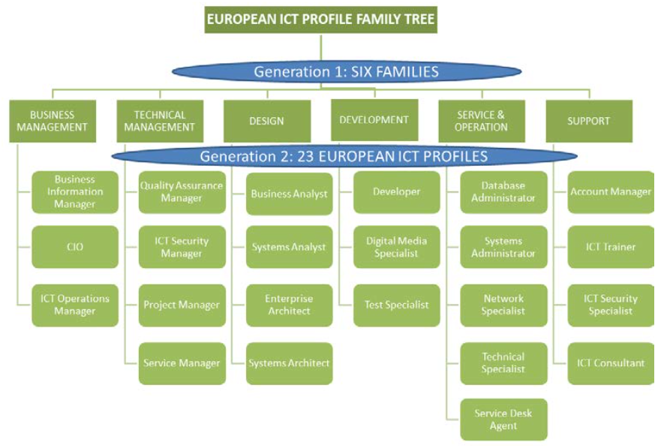
e-CF: Job profiles

Slide 18
What is e-CF
A competence framework
(with annexed job profiles)
A common language
An official standard

Slide 19

What is e-CFplus
Based on e-CF
Enriched in dimension 4
A competence framework
A certification system
Evolution of
EUCIP certifications
e-CFplus Fundamentals
based on
Plan, Build, Operate
& ITAF
Services offered to companies and professionals
Evolution of
EUCIP services

Slide 20
Budapest public meeting
20 October 2016
Thank you for your attention
p.ravotto@aicanet.it
CreativeCommons: Attribution – Share alike.
You are free to use, modify and distribute this presentation citing the original author and leaving the same rights on the resulting product.

